Slide 1


ANALYSIS OF AIRBNB DATA
DASHBOARD

Slide 2

CRISP-DM
Airbnb company analyst data by using Cross-Industry Standard Process for Data Mining methodology followed below steps:-
Business Understanding
Data Understanding
Data Preparation
Modeling
Evaluation
Deployment

Slide 3
Business Understanding
Business Objective
The primary objective is to analyze Airbnb data to reveal insights into user experiences and satisfaction levels with the numerous listed stays, all accomplished using Power BI.
Project Goals
Assessing District Location Scores: The aim is to pinpoint the location in the district with the least favorable location scores.
Examining Host Response Time Impact: The goal is to delve into the relationship between host response times and the overall ratings of Airbnb listings providing valuable insights.
Visualizing Airbnb Listing Prices: The objective is to create visual representations of Airbnb listing prices across different cities and summarize any noteworthy trends or variations.
Analyzing Composite Scores: The task involves creating a composite score that integrates check-in experience and host communication for various districts with subsequent analysis and insights.
Calculating Listing Age and Host Tenure: This objective entails computing the age of Airbnb listings and identifying hosts who have accumulated more than ten years of hosting expertise.
Property Type Price Analysis: The task involves the creation of a visual tree map that displays average prices for various room and property types with specific attention given to the property type associated with the highest prices for entire places.
Crafting a Comprehensive City Insights Report: This objective entails the creation of a comprehensive report that presents listing prices, guest ratings, and visitor trends for multiple cities, with a particular focus on assessing changes in visitor trends in 2020 in contrast to earlier years.

Slide 4
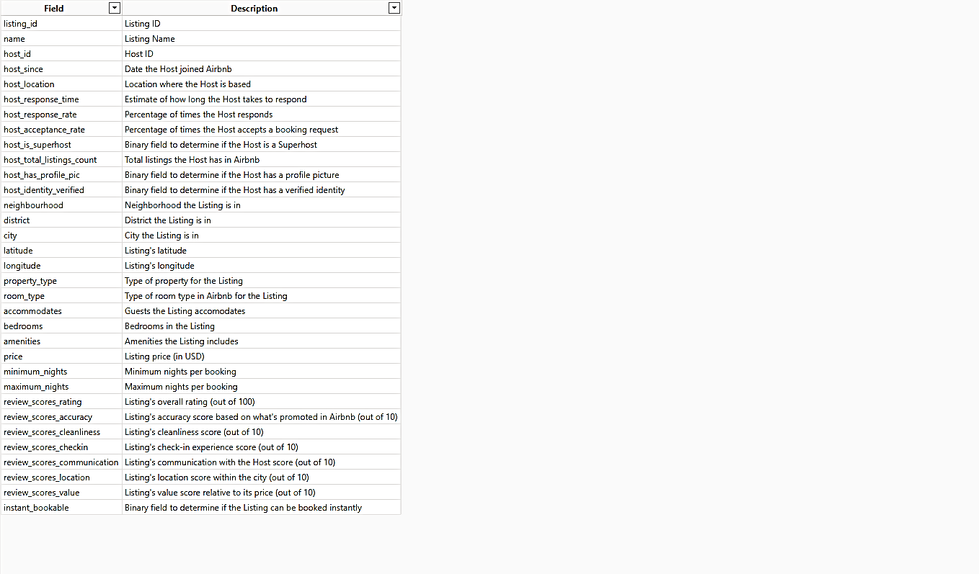
Data Understanding
After gaining a through understanding of the business requirements, we accessed the data to explore it further, aiming to identify any errors & clean the data for better understanding for business. These are columns involved in business understanding are as follows:

Slide 5
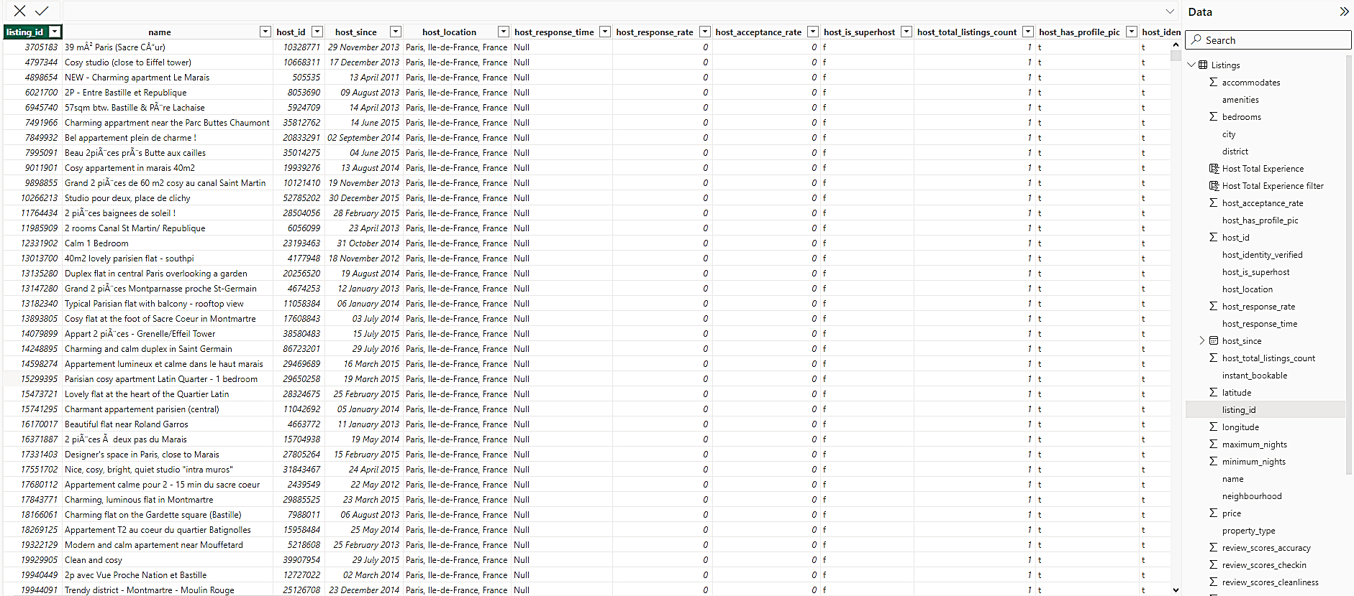
Data Preparation
After completing the phases of business understanding and data understanding, we conducted “Data Preparation”. During this phase, We fill the missing values for data analysis and using the Dax function for complete the project goals are as follows :-

Slide 6
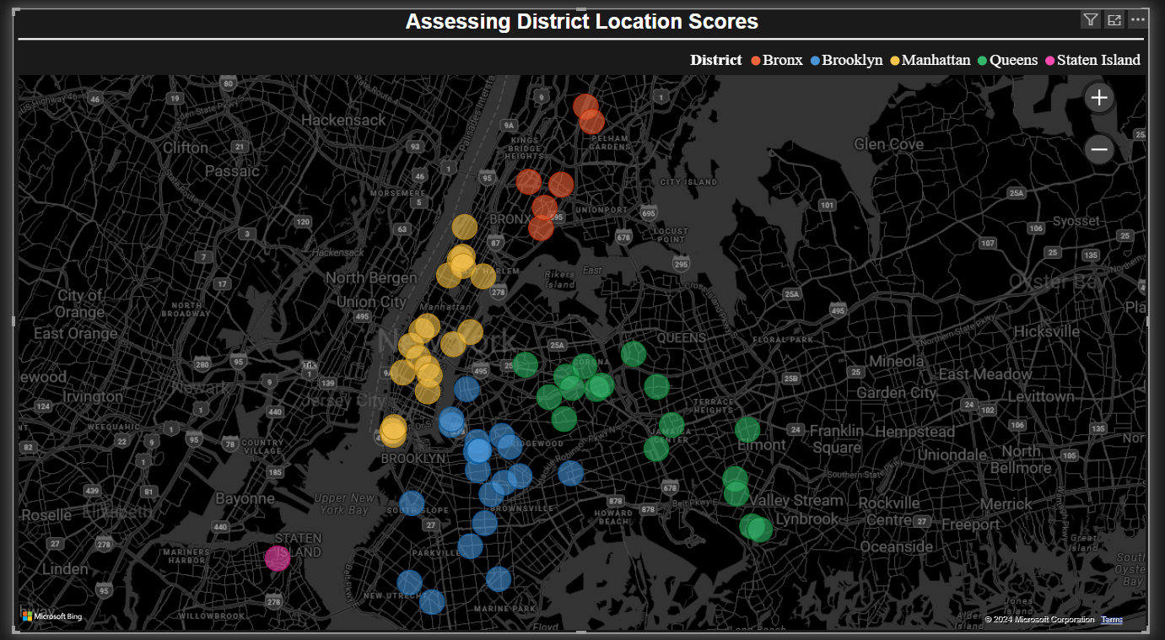
Modeling & Evaluation
In Modeling and Evaluation, we filter the data and for better understanding. We are using multiple charts like - line chart, stacked area chart, scatter chart, treemap & decomposition tree to summarize the data for insights are as follows :-
Assessing District Location Scores: We pinpoint the location in the district by taking latitude, longitude, Average review scores location & district columns to filter data in least favorable location scores. All the things are explained in detail from the map graph given below :-

Slide 7
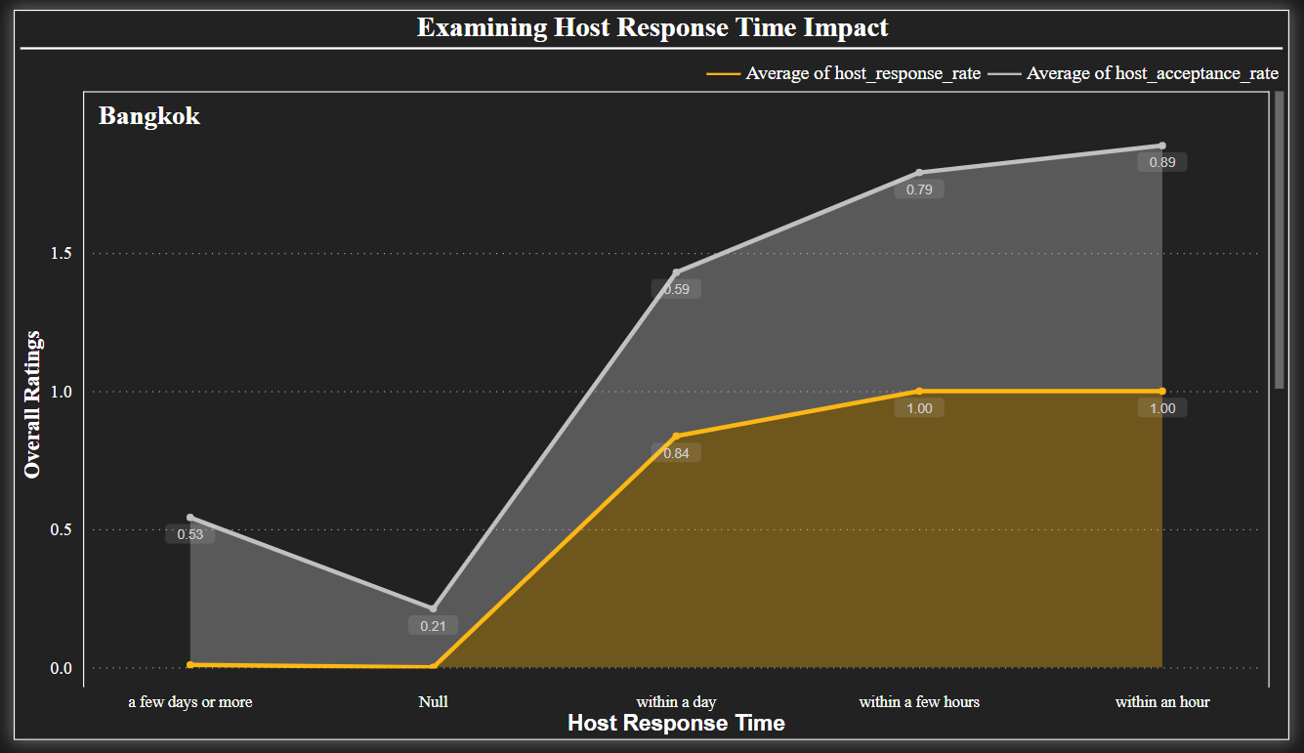
Examining Host Response Time Impact: We used stacked area chart graph, where X axis represents host response time and Y axis represents average host response rate & average host acceptance rate for more insights. We are using the city in small multiple for better understanding this point.

Slide 8
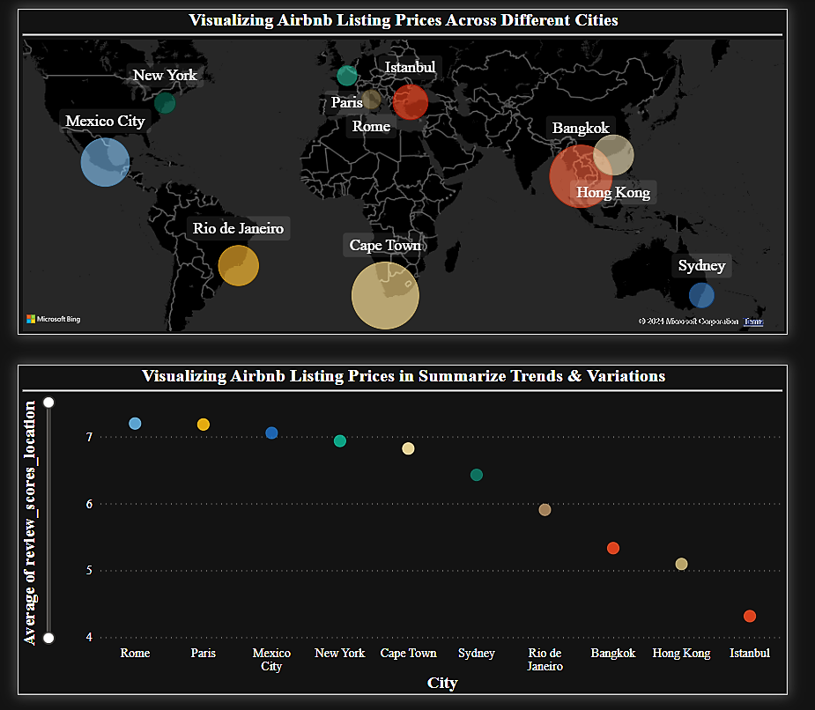
Visualizing Airbnb Listing Prices: 1. Visualizing Airbnb Listing Prices Across Different Cities by using Map graph, where location indicates city and bubble size indicates average of price.
2. Visualizing Airbnb Listing Prices in Summarize Trends & Variations by using scatter chart graph, where X axis represents city & Y axis represents avg of Listing's location score within the city (out of 10).

Slide 9
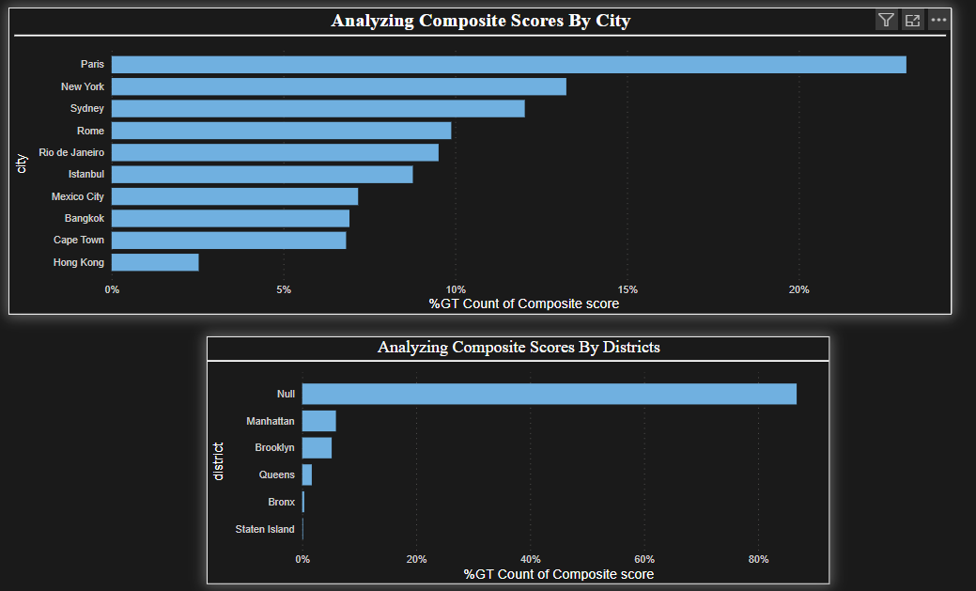
Analyzing Composite Scores: 1. Analyzing Composite Scores By City by using stacked area chart graph, where X axis represents city and Y axis represents % count composite score .
2. Analyzing Composite Scores By City by using stacked area chart graph, where X axis represents districts and Y axis represents % count composite score .

Slide 10
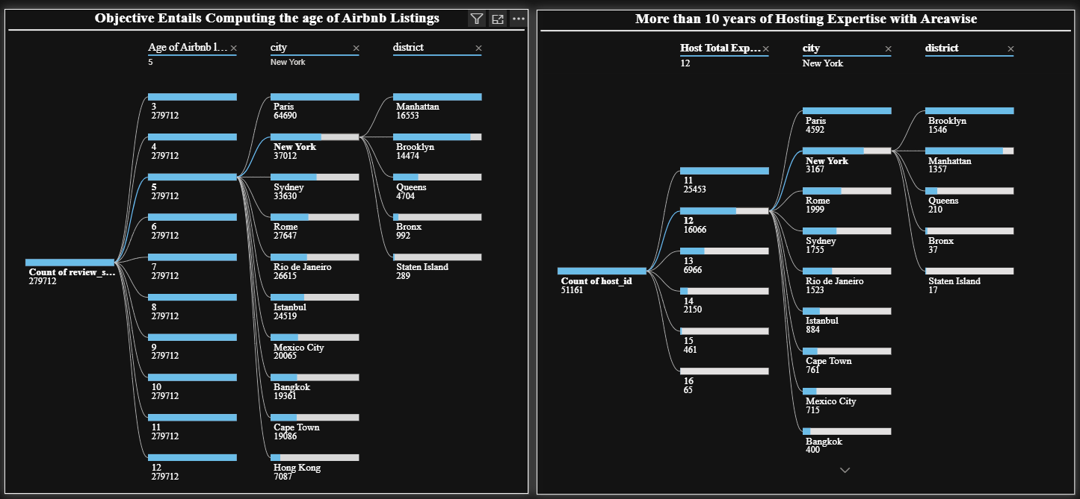
Calculating Listing Age and Host Tenure: 1. Objective Entails Computing the age of Airbnb Listings By using Decomposition tree graph, where analysis field put review_scores_accuracy & explain by is Age of Airbnb listings, city & district.
2. More than 10 years of Hosting Expertise with Areawise By using Decomposition tree graph, where analysis field put count of host ID & explain by is filter more than 10 years of Hosting Expertise, city & district.

Slide 11
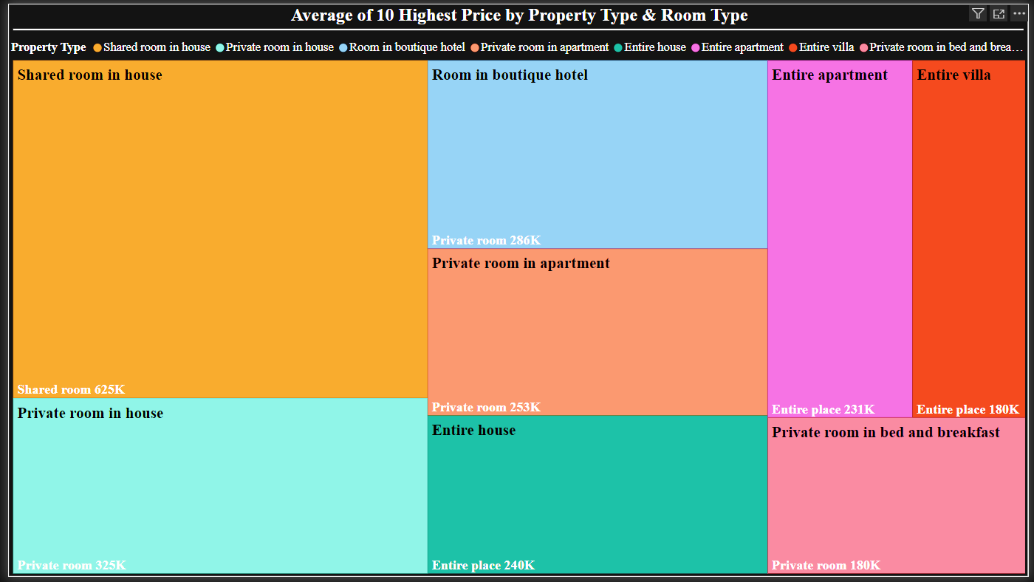
Property Type Price Analysis: Average of 10 Highest Price by Property Type & Room Type By using Treemap graph, where category is property type & details is room type & values is average of price ( filter 10 highest price).

Slide 12
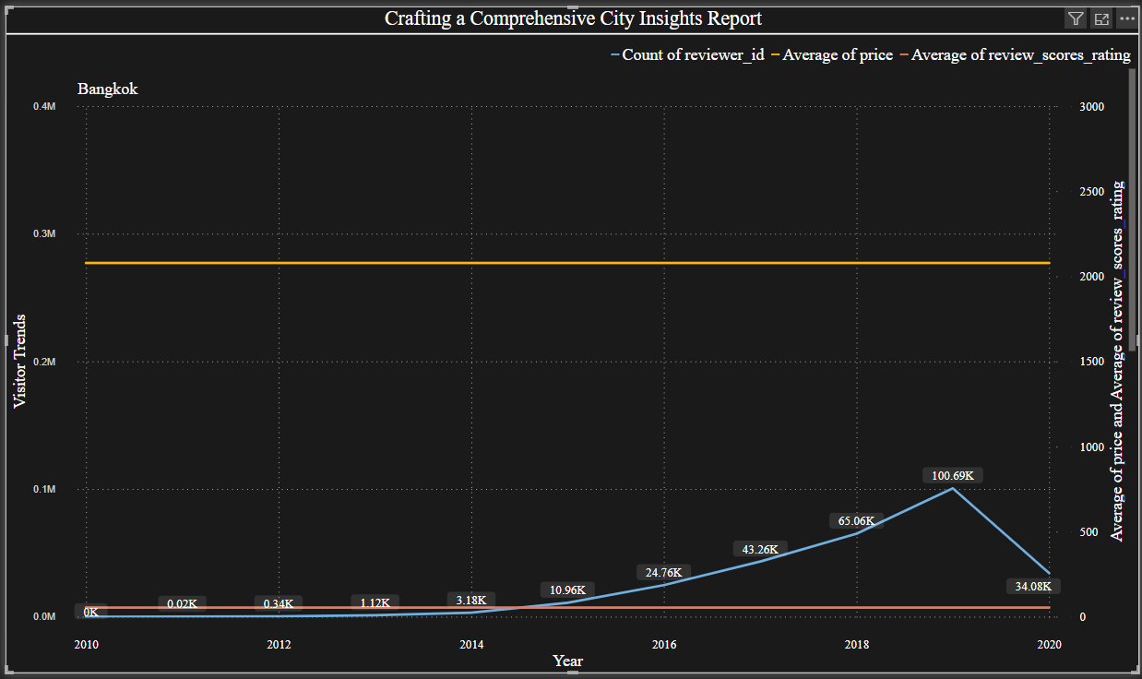
Crafting a Comprehensive City Insights Report: We used using Line chart graph, where X axis represents Year (filter for 2020 in contrast to earlier years)., Y axis represents count of Visitor Trends, Secondary Y axis represents average of price & review_scores_rating & We are using the city in small multiple for better understanding this point.

Slide 13
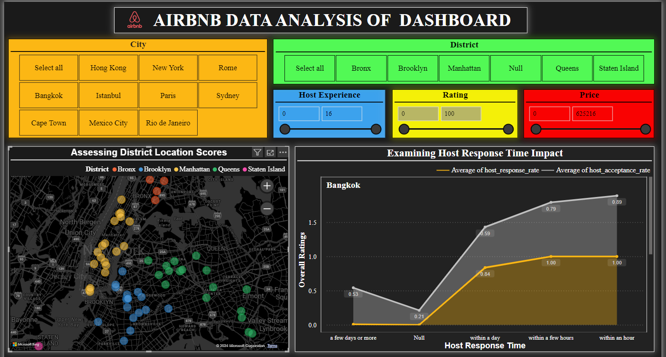
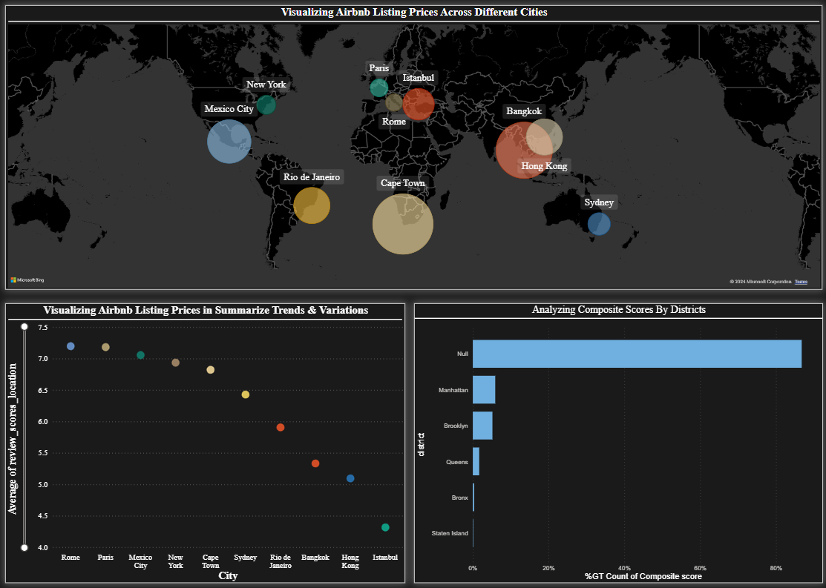
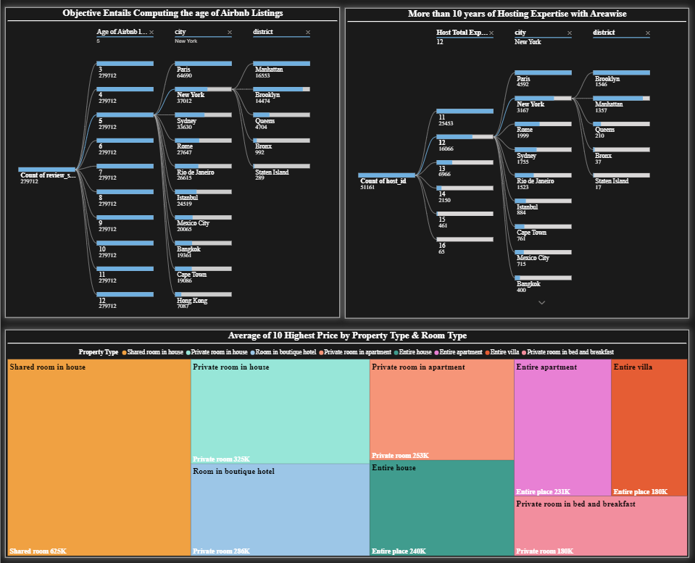
Deployment
By using above Modeling & Evaluation have made an AIRBNB DATA ANALYSIS OF DASHBOARD for a deeper understanding of Airbnb's operations and draw meaningful insights from the data For Real-time monitoring dashboard for tracking all the Project Goals. This will also help to compare different models and identify the best one for the situation.

Slide 14
Recommendations
By observing the above dashboard now, we can recommend Airbnb as follows :-
Assessing District Location Scores: I can recommend some factors to consider when choosing a place to live in New York City: Budget, Commute, Lifestyle & School district.
Examining Host Response Time Impact: Investigate why the acceptance rate is lower than the response rate. Are hosts rejecting inquiries after responding? Understanding the reasons behind rejections could help improve the overall booking experience.
Visualizing Airbnb Listing Prices: In this graph the average of review scores location on the basis of the city is given. In this rate is given out of 10 and below 7 is needed to be improved.
Analyzing Composite Scores: We have work on composite score (check in experience and host communication) in city hong kong and Statend island.
Calculating Listing Age and Host Tenure: Companies with a presence in multiple locations may be able to offer more geographically diverse hosting options.
Property Type Price Analysis: Budgeting for accommodation, weigh the options between shared or private rooms in houses or apartments based on your needs. If privacy and space are a priority, consider paying more for an entire place. Compare prices and amenities across different listings in your preferred location to find the best fit.
Crafting a Comprehensive City Insights Report: A seasonal trend in the data, with prices fluctuating throughout the year & an overall increasing or decreasing trend in listing prices over time.

Slide 15
THANKYOU!

